Slide 1


ECEN 403
LANL Neuromorphic Chip:
Adam O’Brien
Cason Love
Dr. Michael Saccone (Sponsor)
Pranav Dhulipala (TA)

Slide 2
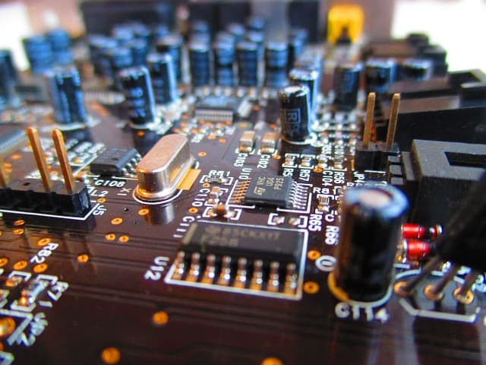
Executive summary
Problem statement:
Limits of conventional computing
Need smaller scale Neuromorphic Chip
Our Neuromorphic Chip will:
Recognize activation phrase from user
Rid the need of analog-to-digital conversion
Less transistors

Slide 3
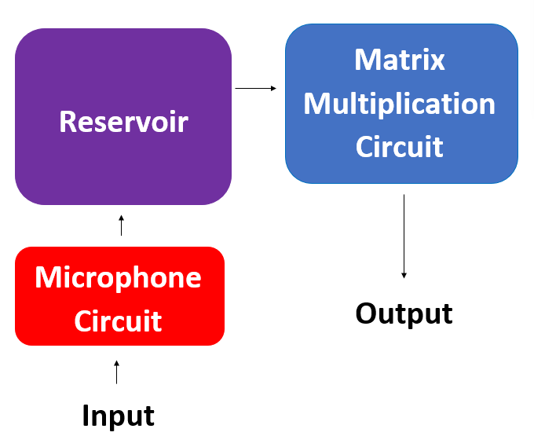
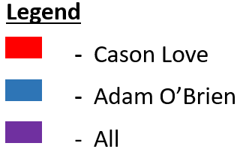
System Overview
Notes:
Cloud server and database

Slide 4
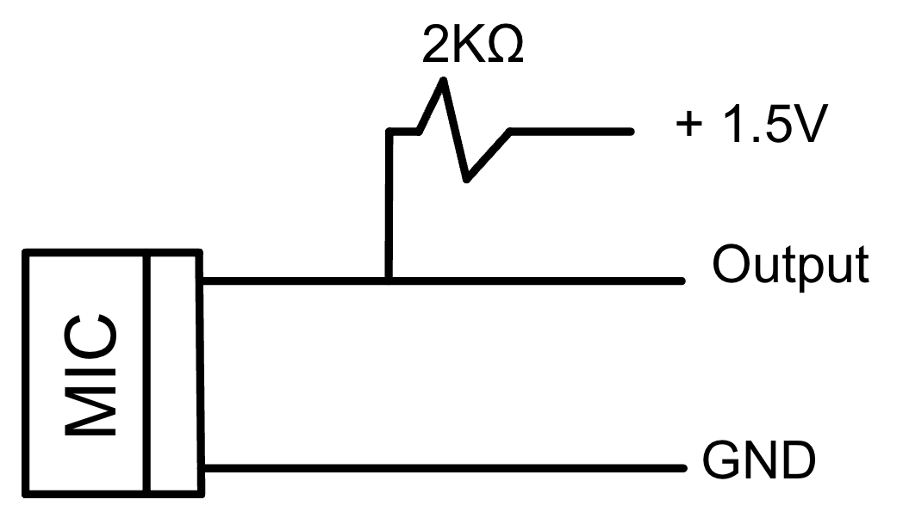
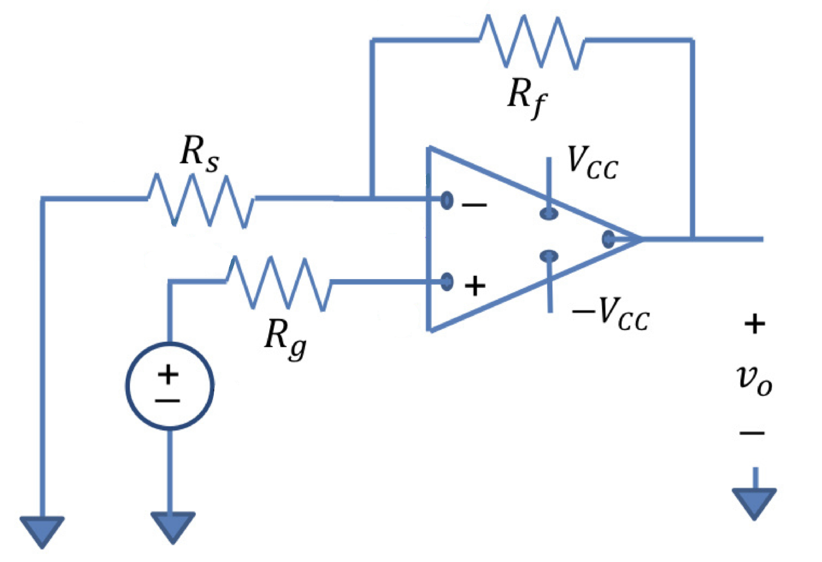
Microphone Subsystem (Cason)
Completed
Built on breadboard
Breadboard output validated
In Progress
Built on perfboard
Perfboard output validated

Slide 5
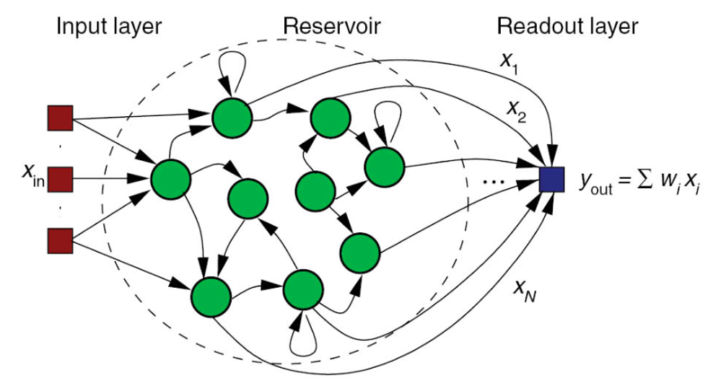
Reservoir Subsystem (Cason and Adam)
Completed
Built first Neuron on breadboard
In Progress
Testing first Neuron
Build rest of Neurons on perfboard

Slide 6
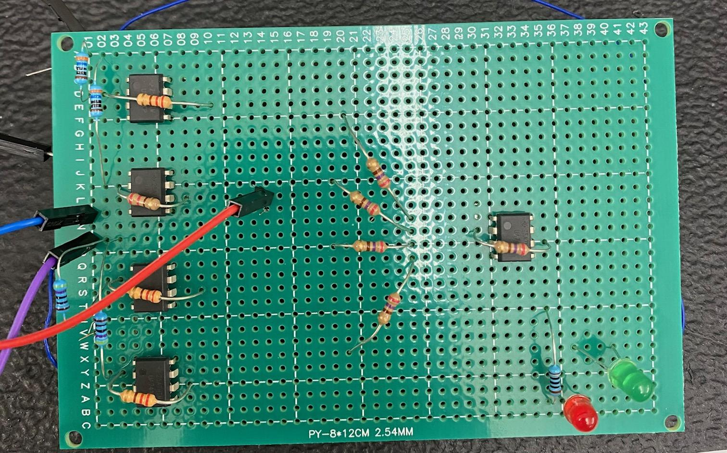
Matrix Multiplication Subsystem (Adam)
Perfboard completed
Tested and verified

Slide 7
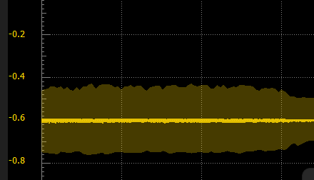
Matrix Multiplication Subsystem (Adam)
Completed
Designed and simulated circuit
Tested circuit on breadboard

Slide 8
Execution Plan
 | March 7th | March 28th | April 4th | April 11th
Microphone Circuit | Microphone Circuit Built on Breadboard | Microphone Output Validated on Breadboard | Perfboard Built | Microphone Output Validated on Perfboard
Reservoir | Single Neuron Built | Each type of Neuron Validated on Breadboard | All Neurons Built on Perfboard | Reservoir Validated on Perfboard
Matrix Multiplication Circuit | Inverting Amplifiers Built and Validated | System Validated on Breadboard | System Built on Perfboard | Final Testing and Validation Completed

Slide 9
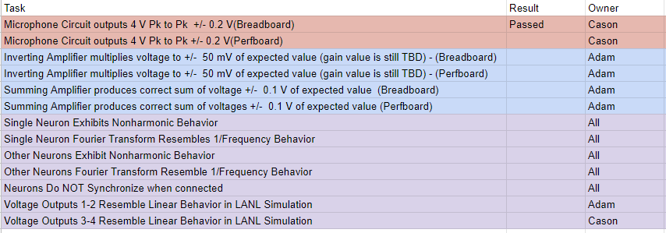
Validation Plan

Slide 10
Bibliography
https://www.howtogeek.com/26898/the-how-to-geek-guide-to-computer-microphones/
https://www.wyzant.com/resources/lessons/math/precalculus/matrices/matrix_multiplication/
https://www.analogictips.com/general-tips-preventing-problems-analog-circuits/

